Slide 1
Gravity Compensation Control of da Vinci Robot
RBE501 Robot Dynamics
Professor Fischer
Alex Rutfield
Amaid Zia
Brandon Boos
Junius Santoso
Nuttaworn Sujumnong
28 April 2015
Notes:
Alex-everyone has to say their name

Slide 2
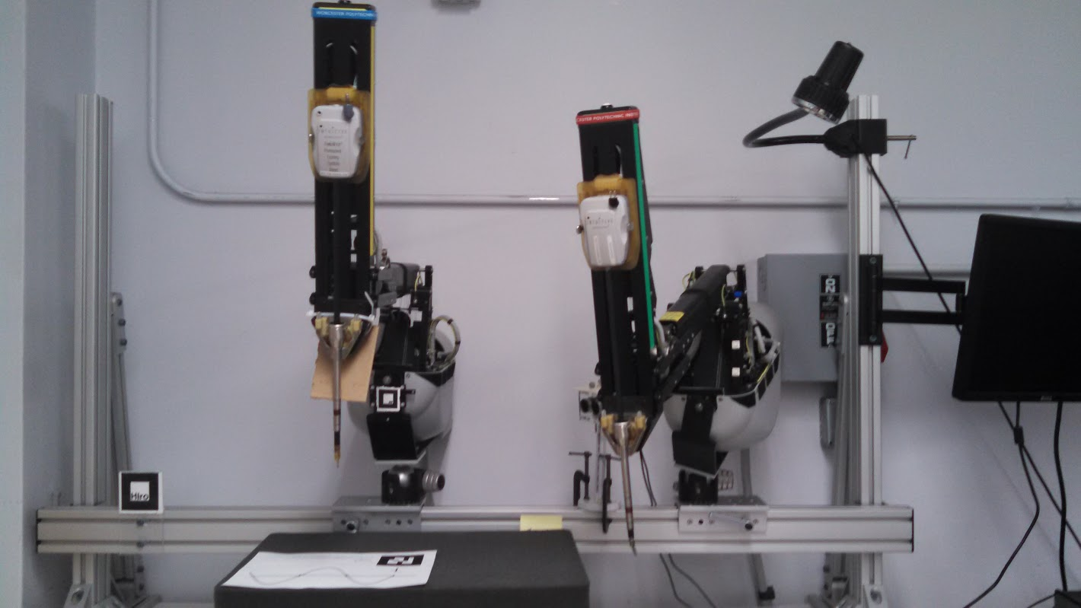
Agenda
Background
Project Objectives
Methodology
Results
Conclusion
Future Works
Notes:
Alex
background-talk about da vinci
objectives for project-psm model/gravity compensation
methodology-how we did it
results-how successful we were
wrap up with conclusion and future works

Slide 3
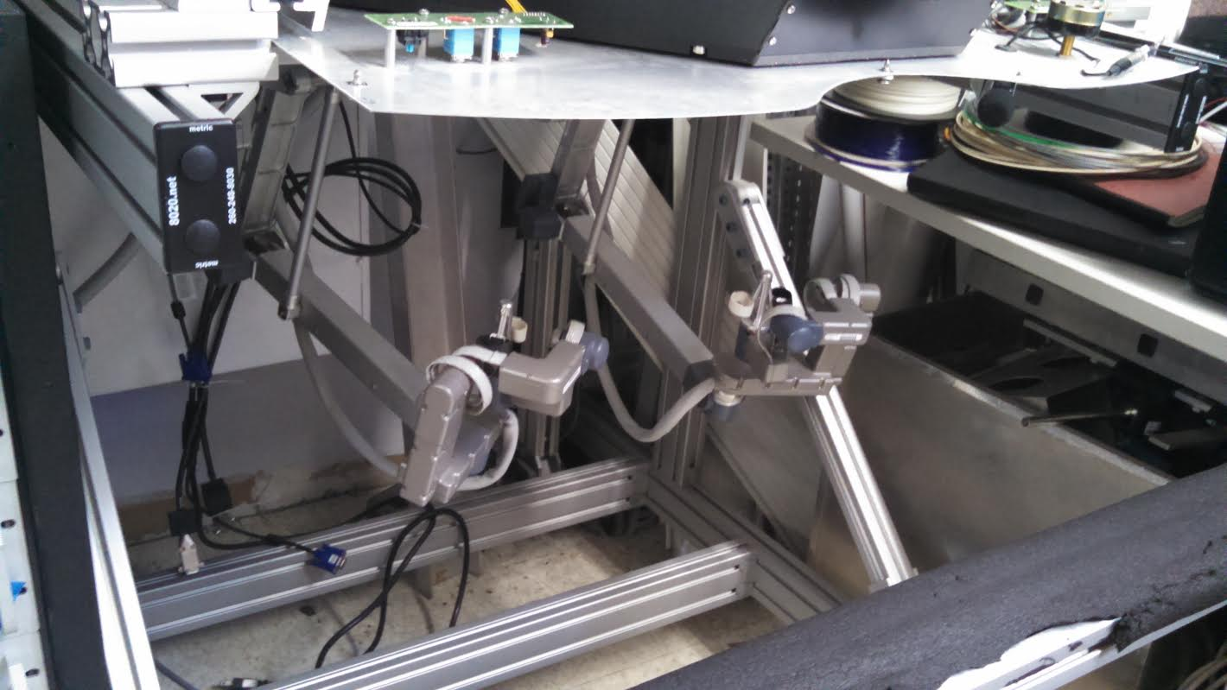
Background and Need
Information about da Vinci Surgical System
Used for minimally invasive surgery
Master arm has eight DOF
Slave has seven
Purpose of project
Add stability for operator
Provide basis for more accurate movement
Notes:
Alex
make a few small incisions to perform tasks, make movements more precise
master arm has 8 dof including pinching (not modeled), slave arm has seven (similar to master)
has control board to communicate btw arms as well as control motion
important for surgeon to control robot optimatlly, don’t want it moving when they release
leads to our project-modeling psm and gravity compensation for master will help with stability/convenience

Slide 4
Project Objectives
Derive a mathematical model of da Vinci robot’s master (MTM) arm.
Implement gravity compensation control of the master arm on simulation as well as real robot.
Create a gazebo model of patient side manipulator (PSM) arm.
Notes:
Alex
create model of daVinci robot’s master arm, use it to add gravity compensation control (enable user to keep arm steady when stationary)
use gravity compensation on gazebo simulator make it more accurate
also create a gazebo model for PSM-didn’t exist, so start working on that

Slide 5
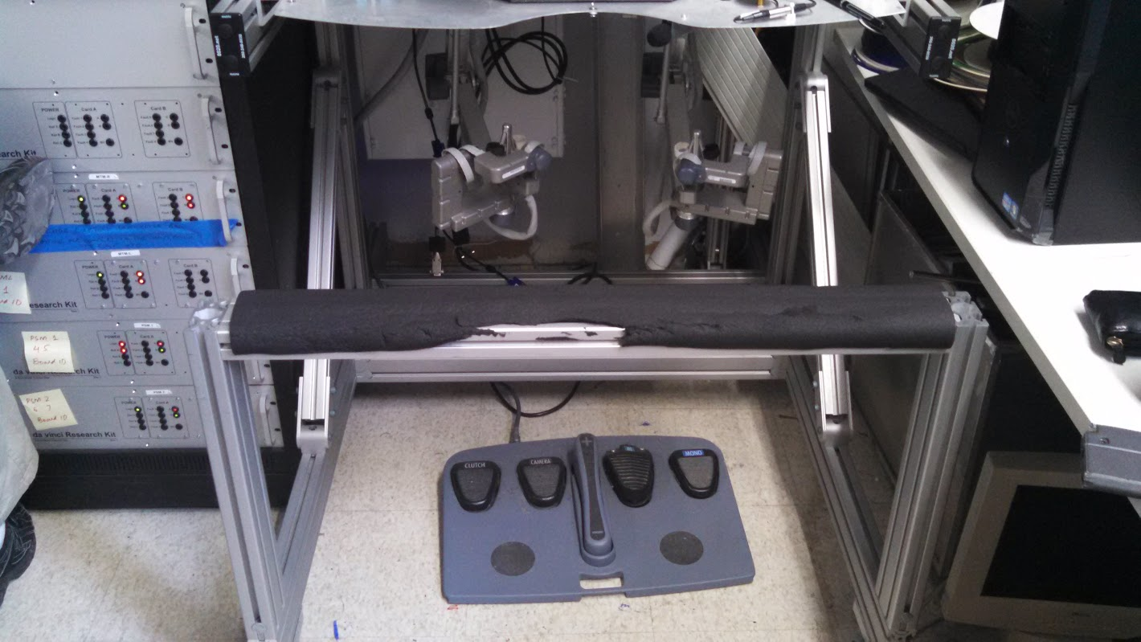
Methodology
Compensation and Control
Forward Kinematics
Robot Mathematical Model
Parameter Identification
Torque Data Collection
Least Square Fit
Control Implementation
Gazebo Modeling
Control of MTM in Gazebo
Generation of PSM Gazebo Model
Notes:
Alex
broke process down into several steps
first find FK of robot
use FK to make mathematical model
Identify unknown parameters using least square/torque data collection (mass, link lengths, center of masses)
use dynamic parameters to control arm in gazebo
finally, create gazebo model of PSM

Slide 6
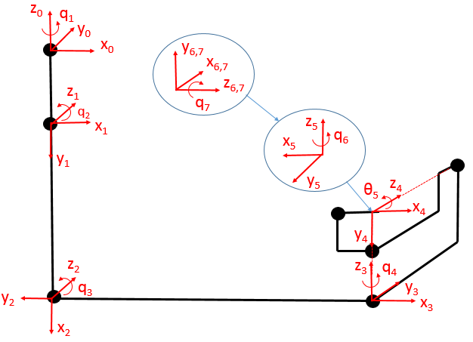
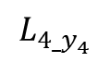
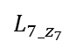
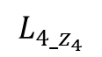
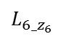
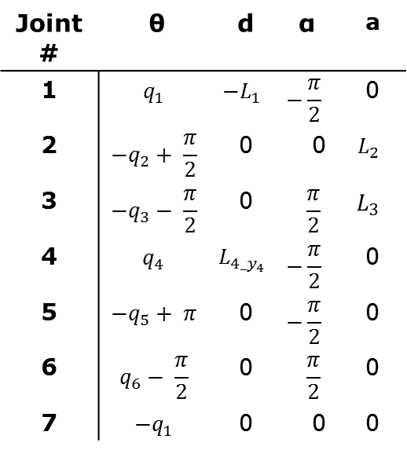
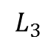
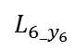
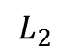
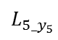
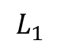
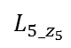
Forward Kinematics
DH Parameters
Joint # | θ | d | α | a
1 | $$q_{1}$$ | $${−L}_{1}$$ | $$−\frac{π}{2}$$ | 0
2 | $${−q}_{2}+ \frac{π}{2}$$ | 0 | 0 | $$L_{2}$$
3 | $${−q}_{3}− \frac{π}{2}$$ | 0 | $$\frac{π}{2}$$ | $$L_{3}$$
4 | $$q_{4}$$ | $$L_{4_y_{4}}$$ | $$−\frac{π}{2}$$ | 0
5 | $${−q}_{5}+ π$$ | 0 | $$−\frac{π}{2}$$ | 0
6 | $$q_{6}− \frac{π}{2}$$ | 0 | $$\frac{π}{2}$$ | 0
7 | $$−q_{1}$$ | 0 | 0 | 0
$$L_{1}$$
$$L_{2}$$
q₅
$$L_{5_z_{5}}$$
$$L_{7_z_{7}}$$
$$L_{4_y_{4}}$$
$$L_{6_y_{6}}$$
$$L_{5_y_{5}}$$
$$L_{6_z_{6}}$$
$$L_{3}$$
$$L_{4_z_{4}}$$

Slide 7
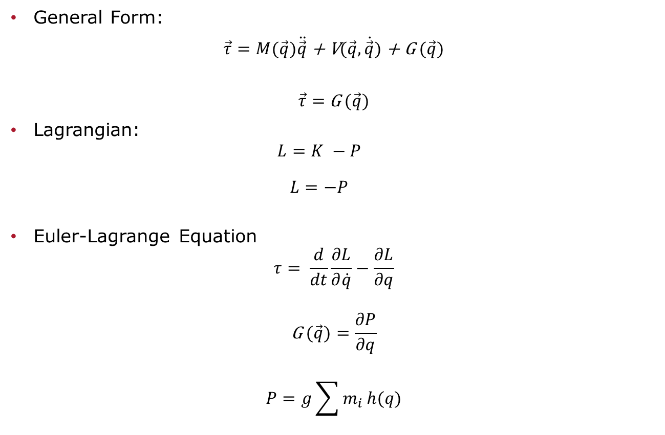
Robot Mathematical Model
General Form:
$\vec{τ}=M(\vec{q})\ddot{\vec{q}}$ + V$(\vec{q},\dot{\vec{q}})$ + G $(\vec{q})$
$\vec{τ}=$G $(\vec{q})$
Lagrangian:
$$L=K −P$$
$$L=−P$$
Euler-Lagrange Equation
$$τ= \frac{d}{dt}\frac{∂L}{∂\dot{q}}−\frac{∂L}{∂q}$$
$$\text{G} (\vec{q})=\frac{∂P}{∂q}$$
$$P=g\sum{m_{i}}h(q)$$

Slide 8
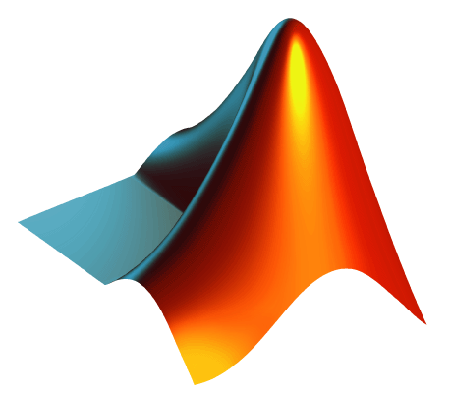
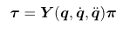
Parameter Identification
Least Square Method (Regression Matrix)
Split the Torques into Two matrices of known and unknowns. Use pseudo inverse to get estimates of unknowns.
Ref: Robotics Modelling, Planning and control by Bruno Siciliano, Lorenzo Sciavicco Luigi Villani, Giuseppe Oriolo
Notes:
Reg and param matrix
Matlab with RST
Problems with getting the torques (collecting data).:
Unstandardized msg types used for the torque values
Workspace was restricted
Joint angle limits were not definitive, they depended upon previous joints
Method of collecting data

Slide 9

Issues with Data Collection
Communication Issues between MATLAB Robotic Systems Toolbox (RST) and ROS
Unstandardized ROS msg types for Torques
cisst/vecDoublev
Workspace Restriction
For some joints the limits were not definitive
Notes:
Matlab does not supported reading of these unstandardized message Types so we had to create our own ROS nodes with which we were able to convert the data to standardized types.
We were hoping to use the limits specified in the already developed software framework but the frame restricted the range of movement of the arm and so we soon realized that those joint limits were not usable for our purposes.
For some joints the range of joint movement changed based on the state of the previous joint. e.g. joint 3 range was based on joint 2

Slide 10
Data Collection Strategy
Requirement:
Collect data over a varying range of arm configurations to get good estimates
Strategy:
Manually move arm to various positions
Record positions
Command (with Matlab) arm to move to those positions
Give a little delay before recording the torques for each pose

Slide 11

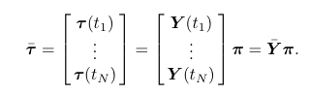
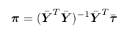
Control Implementation
Method of Estimation
Augmentation of Matrices
Left pseudo inverse
Notes:
How we got the estimates
Augmentation of matrix
Moorse Penrose inverse

Slide 12
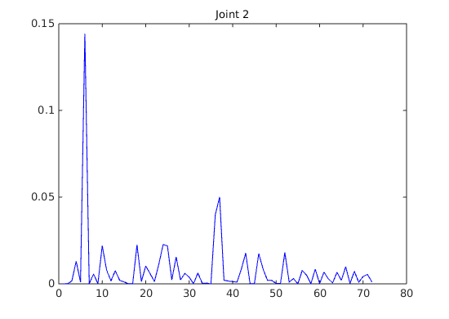
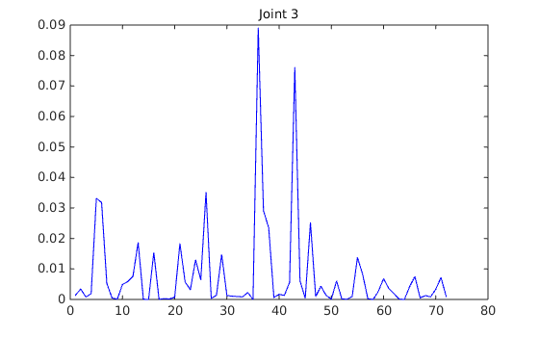
Results (cont.)
Plot of torque error for each joint

Slide 13
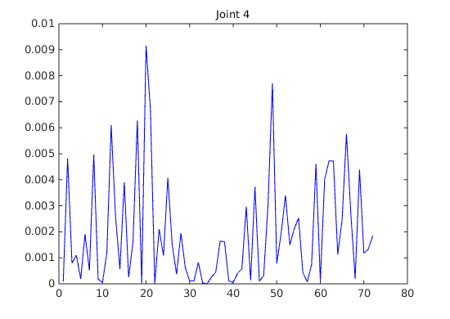
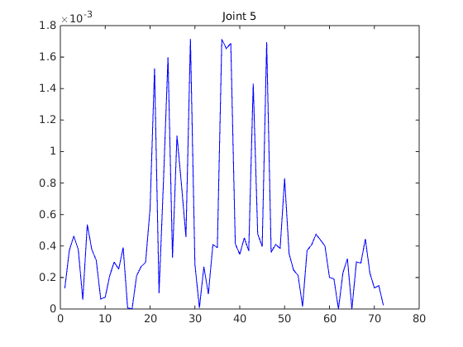
Results (cont.)
Plot of torque error for each joint

Slide 14
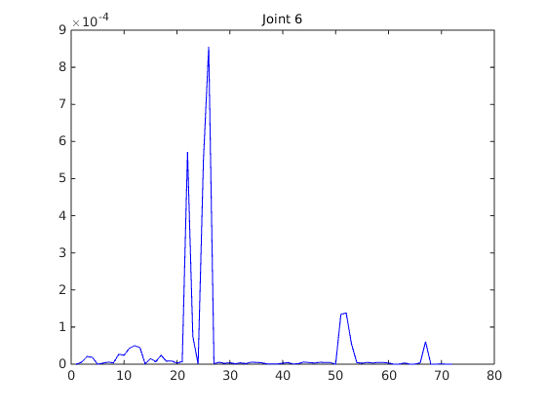
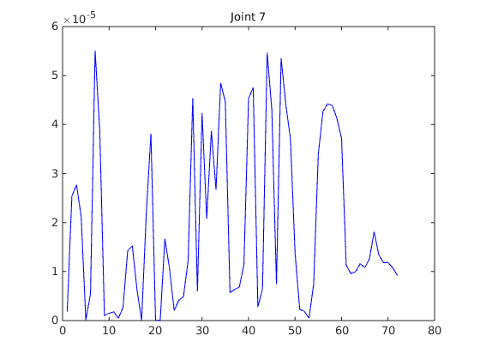
Results(cont.)
Plot of torque error for each joint

Slide 15
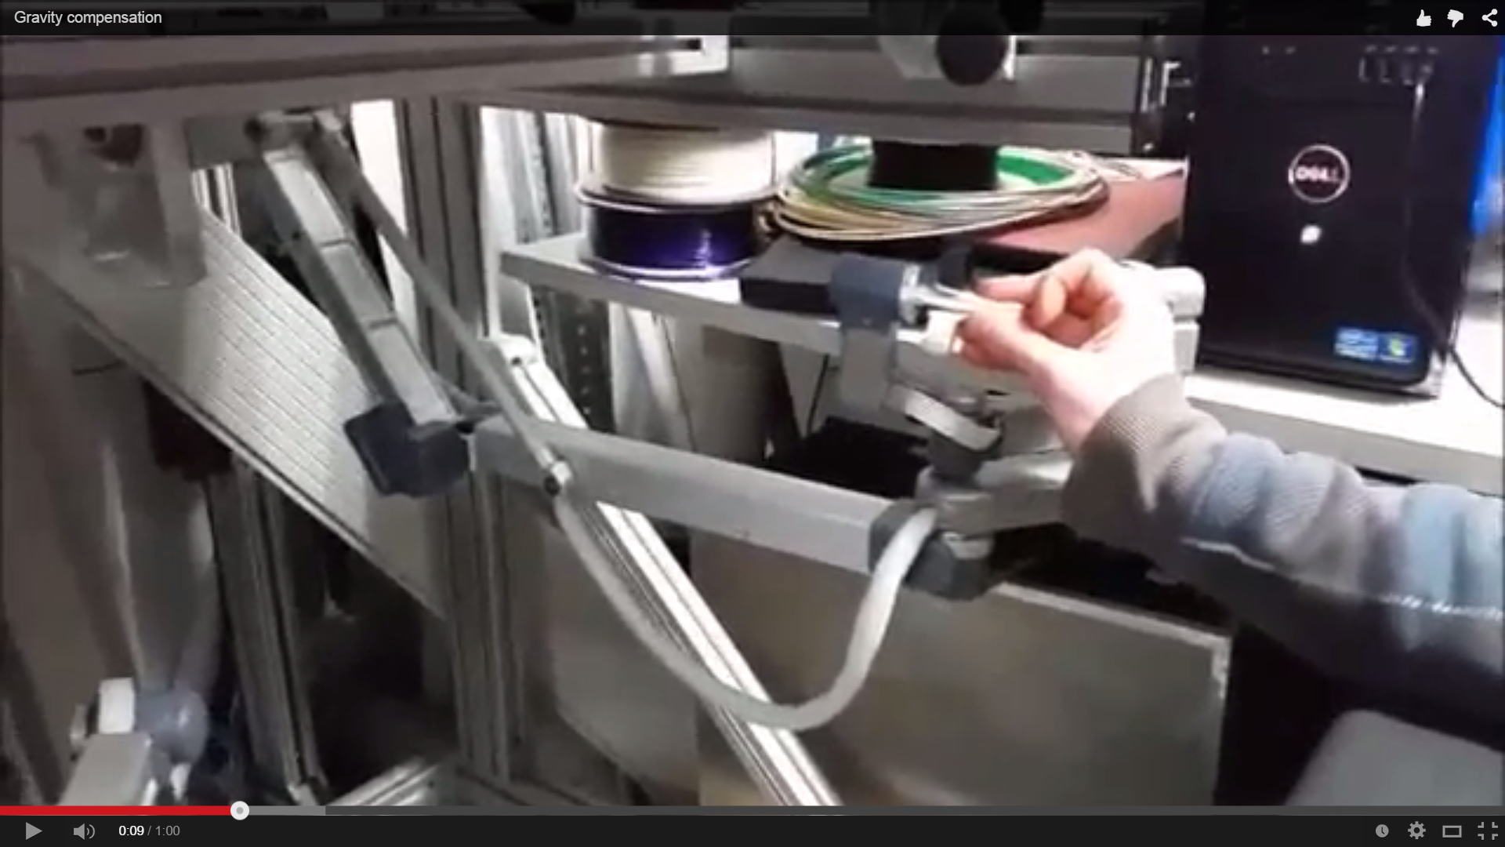
Results(cont.)
Demonstration video
https://www.youtube.com/watch?v=o9JyNBznjvY

Slide 16

Control of MTM in Gazebo
Position (PID) control of MTM arm was available.
Our team created torque control to achieve gravity compensation control. Gravity compensation with PID.
Similar approach to the real robot implementation.
Develop model for given robot configuration (kinematics, center of masses) but this time we don’t have to do the parameter identification since we specified them in the gazebo model.
Notes:
PID position control built in from ROS_CONTROL package. Joint_state_controller.
We added PID torque control from ROS_CONTROL where you can specify the desired joint torque and the controller will try to achieve that value. Joint_effort_controller.

Slide 17
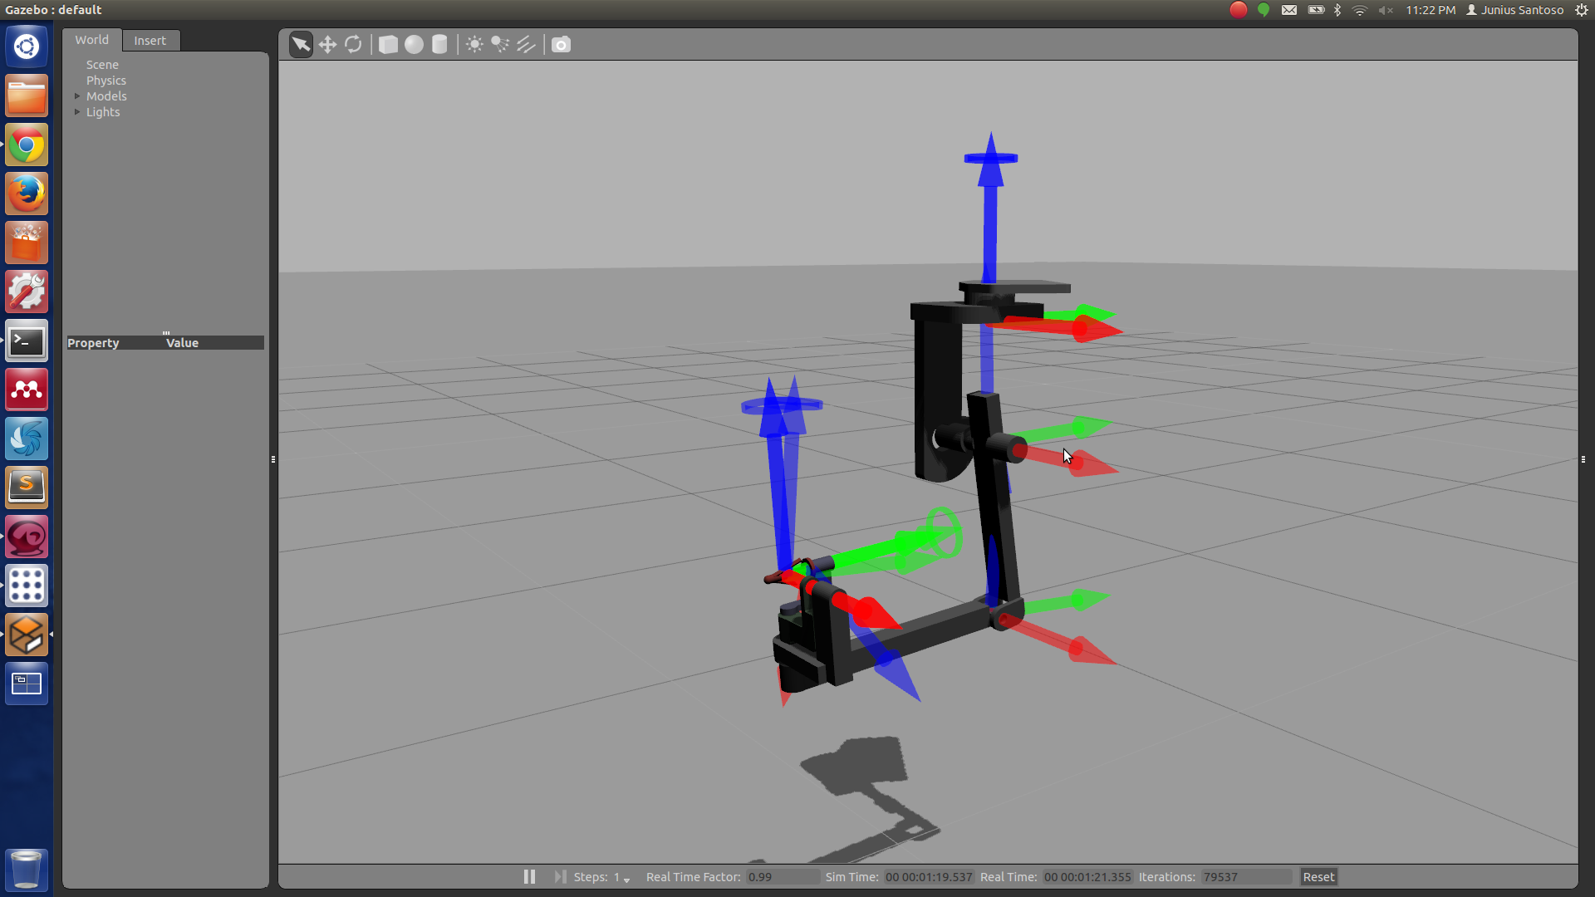
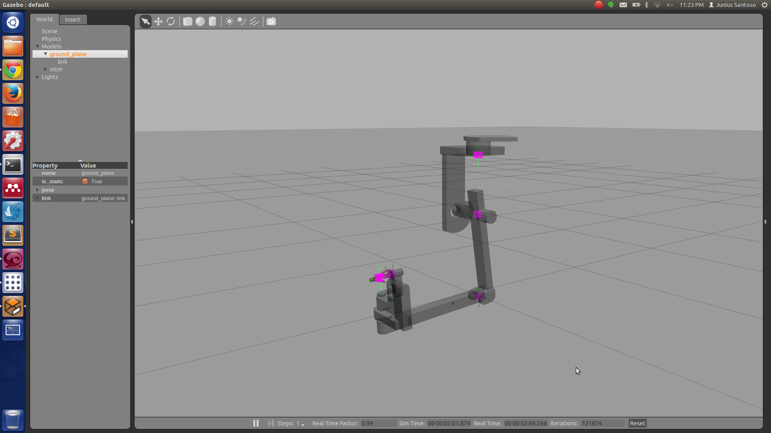
MTM model in Gazebo
Joint locations
Center of masses
Notes:
Figures shown are the gazebo model of MTM arm where the joint and center of mass locations are highlighted.

Slide 18
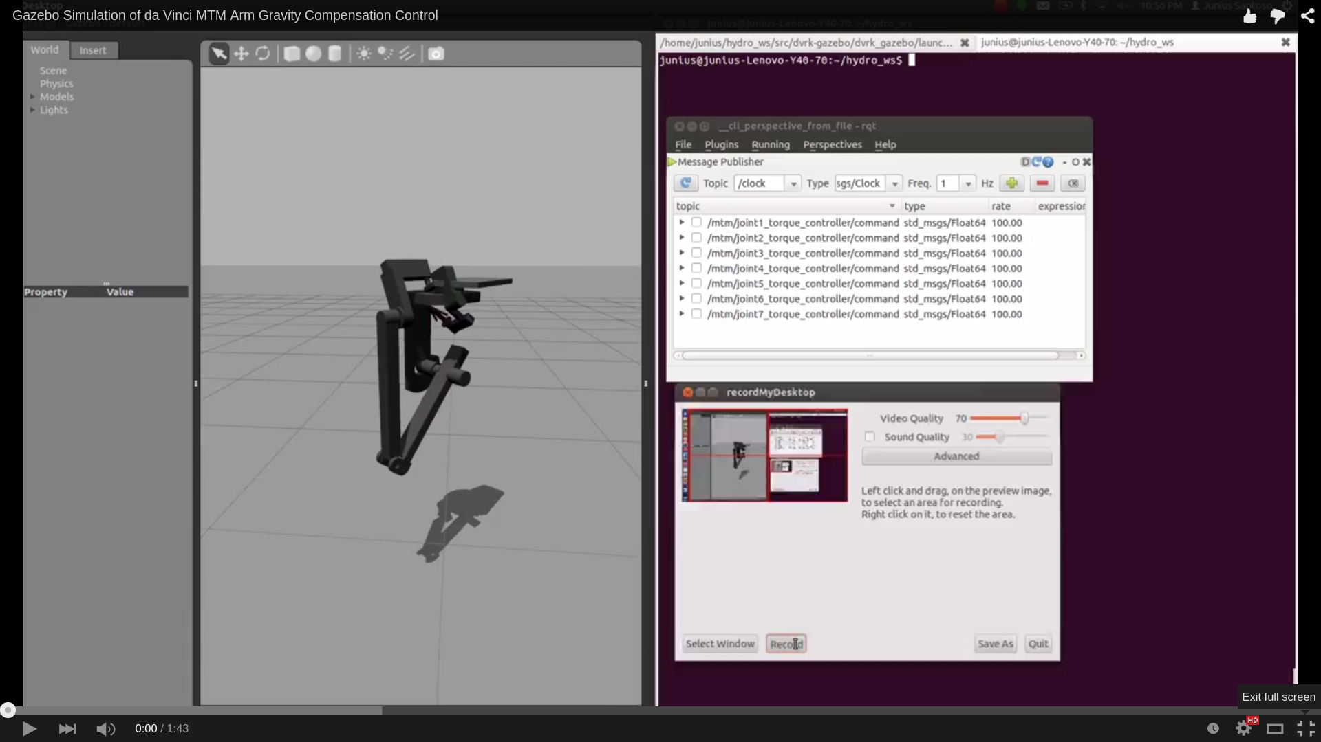
Simulation
https://www.youtube.com/watch?v=SaixGzLoO2I
Notes:
Video capture of the simulation. First I make sure that all the joints have zero torques and then turn on my controller. The robot will try to go to the desired position which in this case is zero radian for all the joint angles and then try to maintain that position.
I have also plotted the joint reading for the simulation the results will be shown in the next slide.

Slide 19
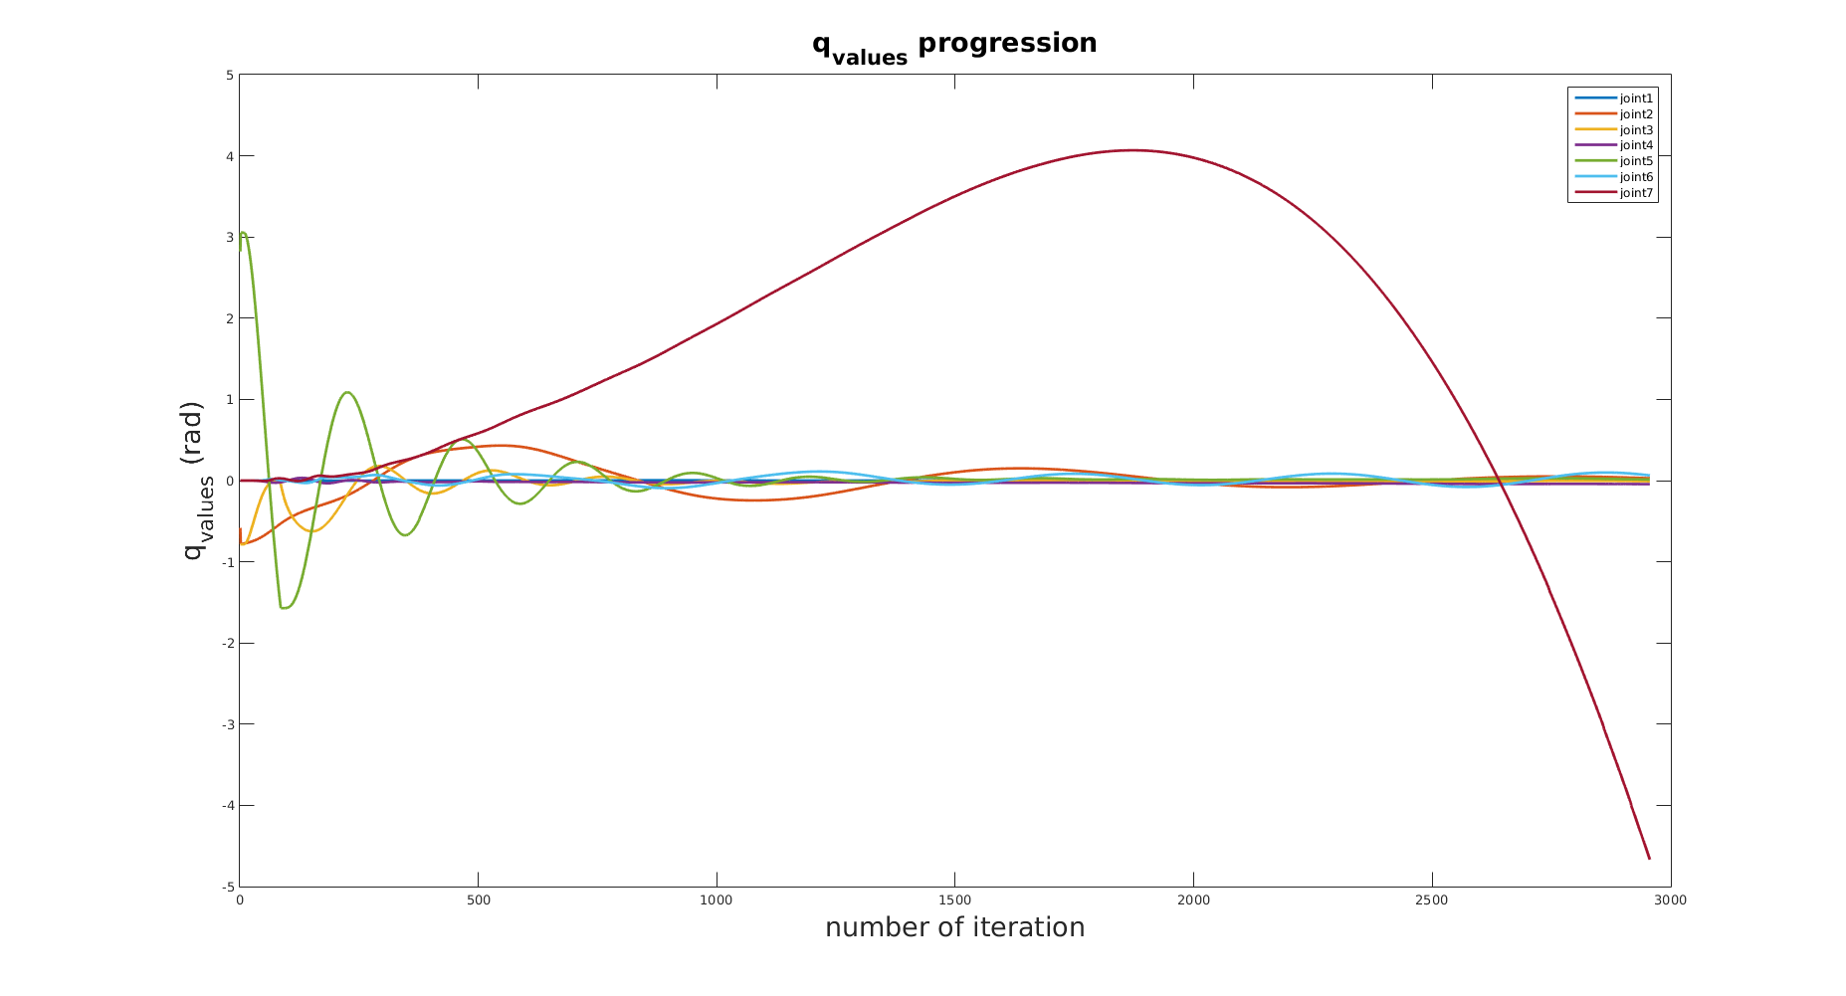
Simulation Results
Notes:
As we can see all the joint values eventually converges to 0 radian with the exception of the last joint. I have tried to tune to the gain to mitigate the error but it didn’t really help. It most likely comes from the fact that ideally the arm would be brought through a certain position and then the gravity compensation will do its job providing just enough torque to maintain the position. But in the simulation we actually used PID loop to correct for the error in position so there is definitely disturbance cause by the effort to bring the arm to the desired position.

Slide 20
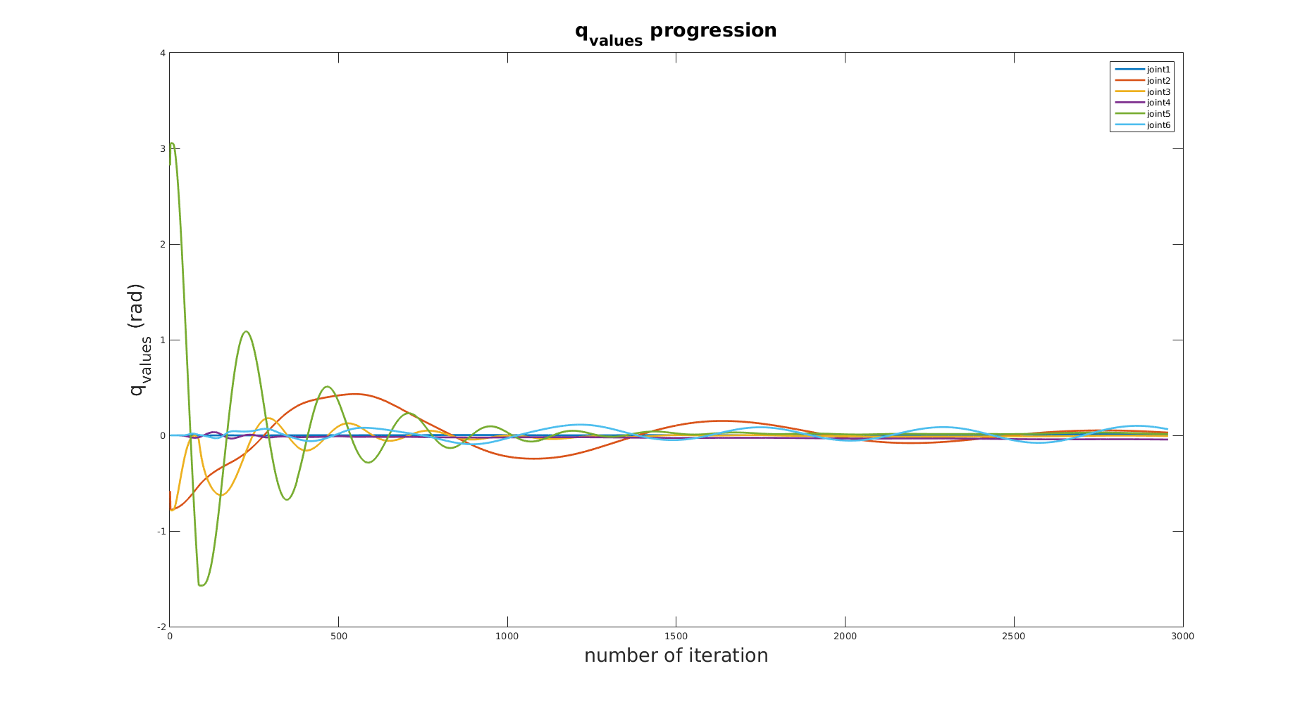
Simulation Results
Notes:
The result without the value for last joint

Slide 21
PSM Model in Gazebo
There is no Gazebo model for PSM arm currently available.
There is a need to create PSM Gazebo model in SDF format since URDF does not support parallel linkages.
The completed PSM model can be used for future projects.
Notes:
URDF can only specify the kinematic and dynamic properties of a single robot in isolation. URDF can not specify the pose of the robot itself within a world. It is also not a universal description format since it cannot specify joint loops (parallel linkages), and it lacks friction and other properties.
SDF is a complete description for everything from the world level down to the robot level. It is scalable, and makes it easy to add and modify elements.

Slide 22
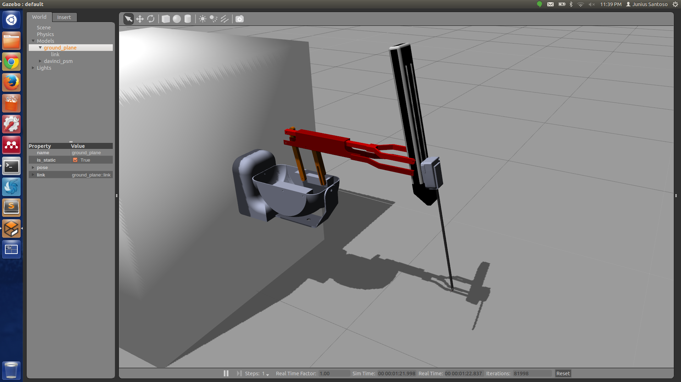
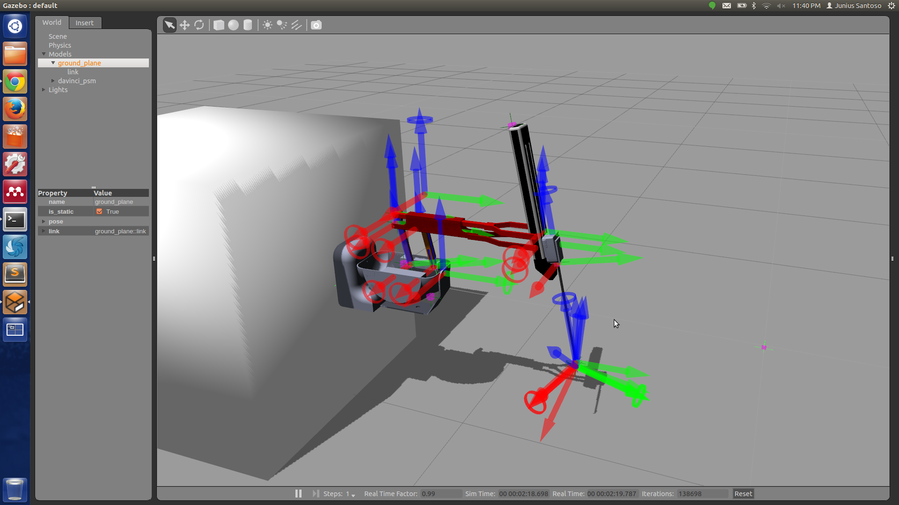
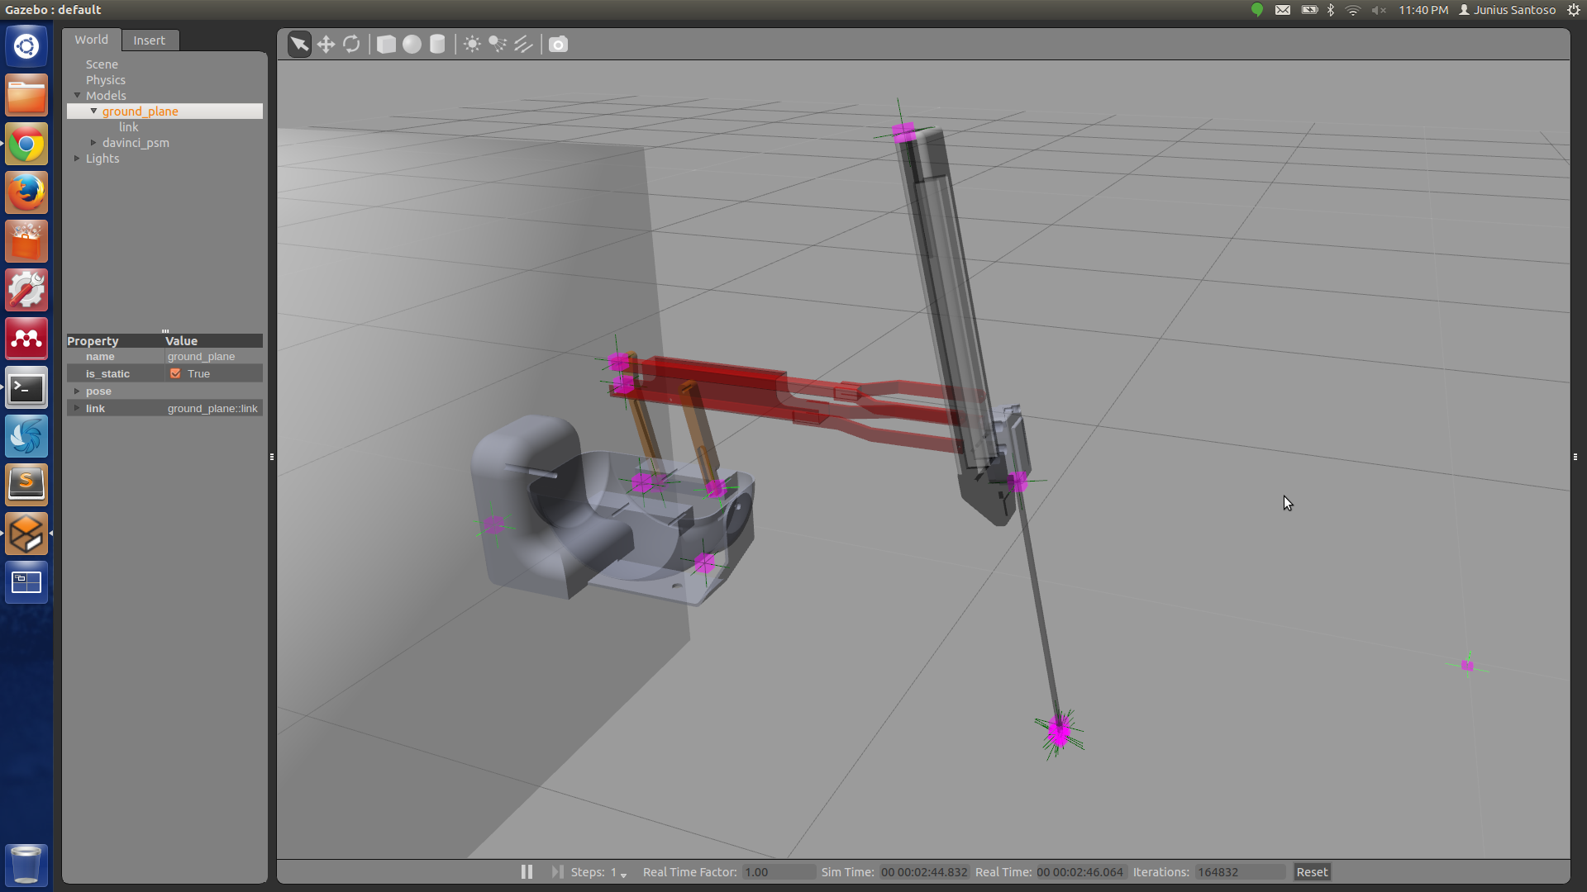
PSM Model in Gazebo
Joint locations
Center of masses
Notes:
Methodology : Assemble the CAD model of PSM in Solidworks and then noted down the coordinates of each part with respect to the base link.
<x y z> < roll pitch yaw >. Center of masses are currently located on the joint. Collada files are used for visual and collision.
All the joints can be controlled through the same torque controller used for the MTM arm, so this can potentially be beneficial for future projects.

Slide 23
Conclusion
The gravity compensation works on most configurations of the master arm
The simulation result of MTM arm agrees with our experimental results
The model of the slave arm is successfully built

Slide 24
Future Works
Improvement of robot stabilization and more precise gravity compensation for master arm
Add gravity compensation for slave arm
Add inertia terms for torque equations

Slide 25
References
Spong, Mark W., Seth Hutchinson, and M. Vidyasagar. Robot Modeling and Control. Hoboken, NJ: John Wiley & Sons, 2006. Print.
Robotics Modelling, Planning and control by Bruno Siciliano, Lorenzo Sciavicco Luigi Villani, Giuseppe Oriolo
A Learning Scheme for the Parameter Identification of Robot Dynamics by Ping-An Bao Ping Jiang Hui-Tang Chen
An overview of dynamic parameter identification of robots by Jun Wu, Jinsong Wang , Zheng You

Slide 26
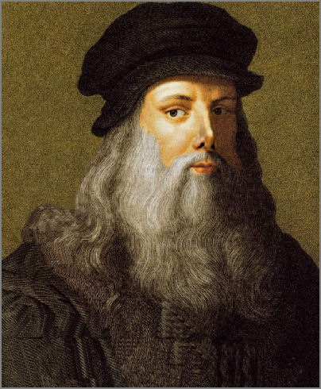
Questions?

